Slide 1
Arden Medical Centre
Patient Satisfaction Questionnaire 2015

Slide 2
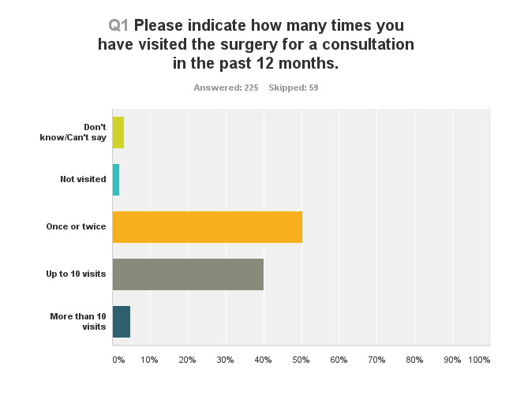
Slide

Slide 3
Slide
I found it easy to book an appointment

Slide 4
Slide
I find it easy to get through on the telephone

Slide 5
Slide
I find the receptionists helpful

Slide 6
Slide
I can book an appointment at a time convenient for me

Slide 7
Slide
I found the waiting time at the surgery acceptable

Slide 8
Slide
I was given enough time with doctor / nurse / healthcare assistant

Slide 9
Slide
I felt listened to

Slide 10
Slide
My treatments and tests were explained to me

Slide 11
Slide
I felt involved with decisions about my care

Slide 12
Slide
Overall my experience at Arden Medical Centre has been positive

Slide 13
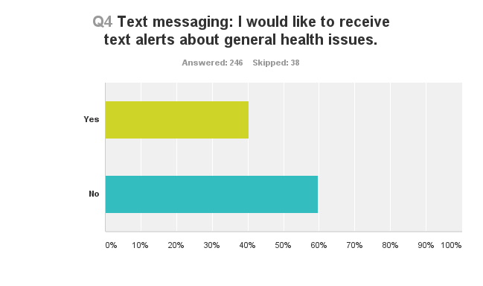
Slide

Slide 14
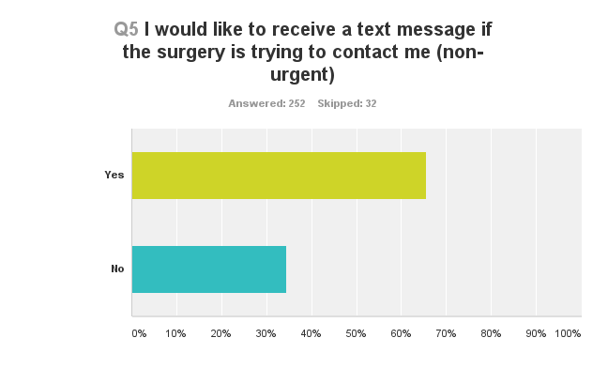
Slide

Slide 15
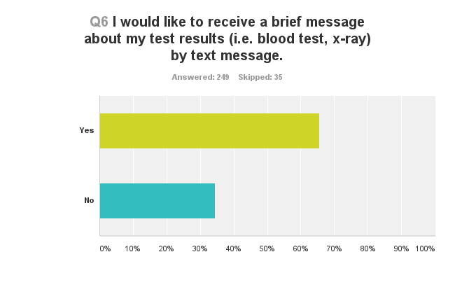
Slide

Slide 16
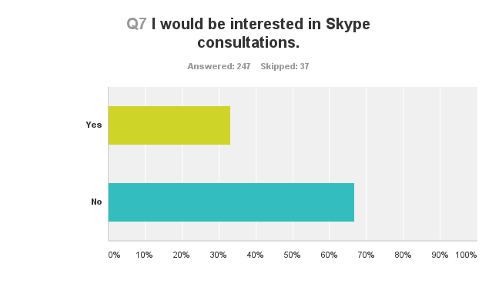
Slide

Slide 17
Slide
Q8. In their own words….
Appointments never run to time, in all my visits over the years I recall every appointment being at least 20 minutes late. An opportunity for patients to meet the "people who run the practice" in a style and format to that of governors and their accountability roles in schools. How does one become involved in contributing ideas to the practice and to whom one can feedback?
Information to all patients about how the practice works
Regular newsletter about surgery news and updates.
No, I think the Arden medical centre are fantastic. Especially compared to other doctor's surgery's. Just don't lower you current standards as the practice will suffer.
Blood tests to take place at the surgery, not hospital
I want face to face consultations , NOT SKYPE, a better waiting area, with windows and a television

Slide 18
Slide
In their own words….
I have recently moved to the area and find this surgery absolutely wonderful thank you
Quality of care from Drs Horton, Bailey and Ullah has been exemplary
That blood tests continue to be taken at the surgery! Travelling to a hospital for some patients may be difficult!
Ability to email requests for repeat prescriptions rather than attending in person
Biggest issue is inability to book early morning appointments in advance. As a family with 2 working parents this is a major issue
Could not improve on service or treatment (great)
Cannot think of any, perfectly satisfied with excellent service already received.

Slide 19
Slide
In their own words….
It would be nice if we could have blood tests done at the surgery again please
It seems very old fashioned to close on Wednesday afternoons. I know all the arguments about why you don't but I think it lets you down as a service.
Best surgery ever
Appointments rarely run on time but that's understandable as the time with the doctor is never rushed
One of receptionists has a rather abrupt manner
Comment re waiting "30 minutes and still waiting on appointment for Sophie (4)
Unable to suggest anything that in my mind find very good; Keep it up!!
Debbie & Fiona are particularly helpful at reception. I receive excellent care from Dr Holt

Slide 20
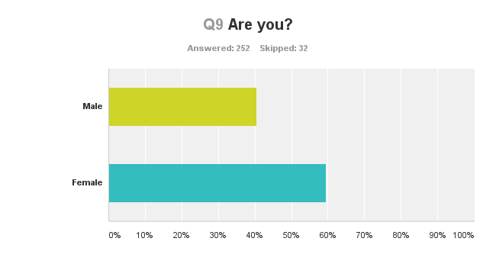
Slide

Slide 21
Slide

Slide 22
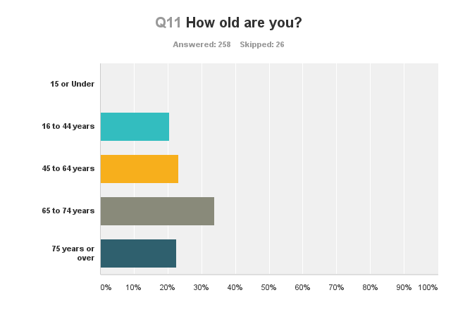
Slide

Slide 23
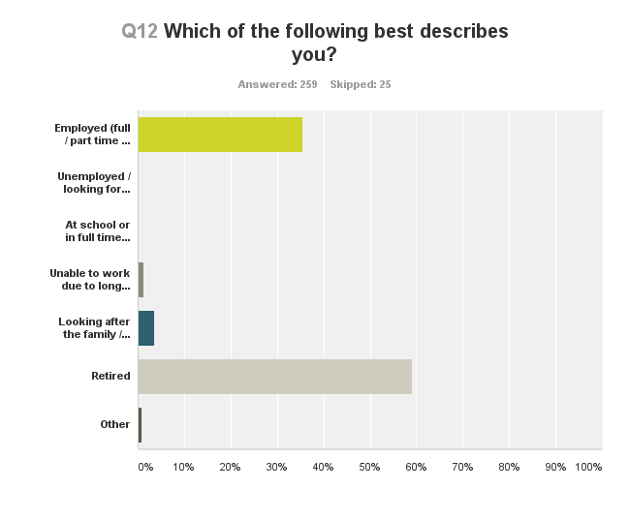
Slide

